Slide 1
Aviation Risk Analysis for Business Expansion
Identifying Low-Risk Aircraft for Commercial and Private Operations

Slide 2
Business Understanding
Problem: The company is expanding into aviation but lacks knowledge about aircraft risks.
Goal: Identify the lowest-risk aircraft for safe and profitable operations.

Slide 3
Data Understanding
Data Source: NTSB Aviation Accident Database (1962-2023).
Key Metrics:
Event.Date: Date of the accident.
Injury.Severity: Severity of injuries (e.g., Fatal, Serious, Minor).
Aircraft.damage: Extent of damage to the aircraft.
Make: Manufacturer and model of the aircraft.
Engine.Type: Engine details.
Total.Fatal.Injuries, Total.Serious.Injuries, Total.Minor.Injuries: Injury statistics.
Weather.Condition and Broad.phase.of.flight: Contextual details about the accident.

Slide 4
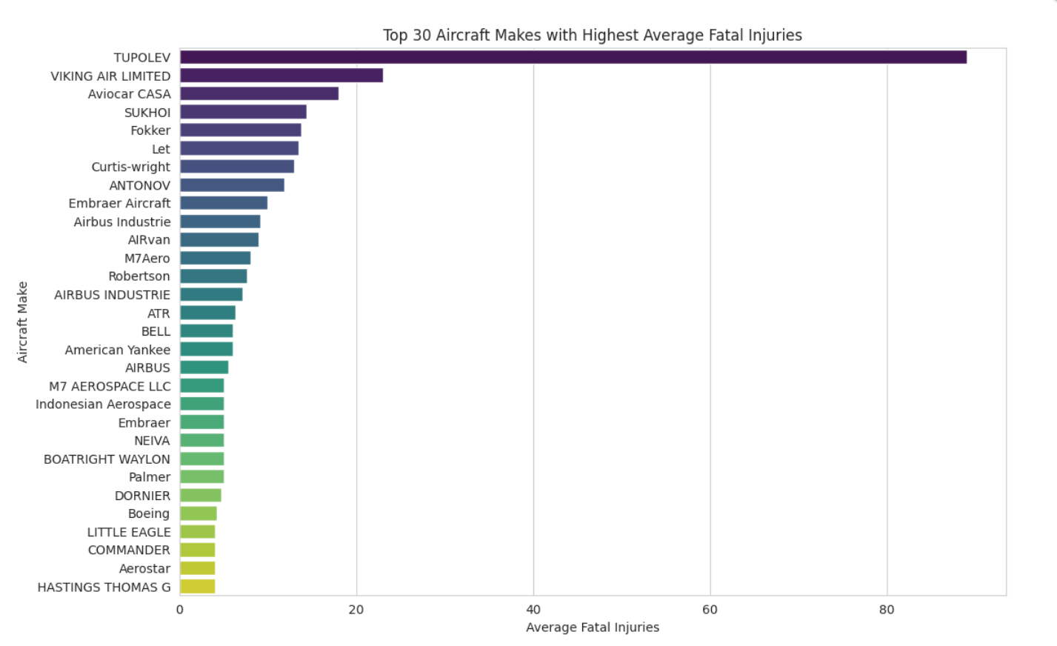
Data Analysis - Top 30 Aircraft Makes with Higher Average Fatal Injuries

Slide 5
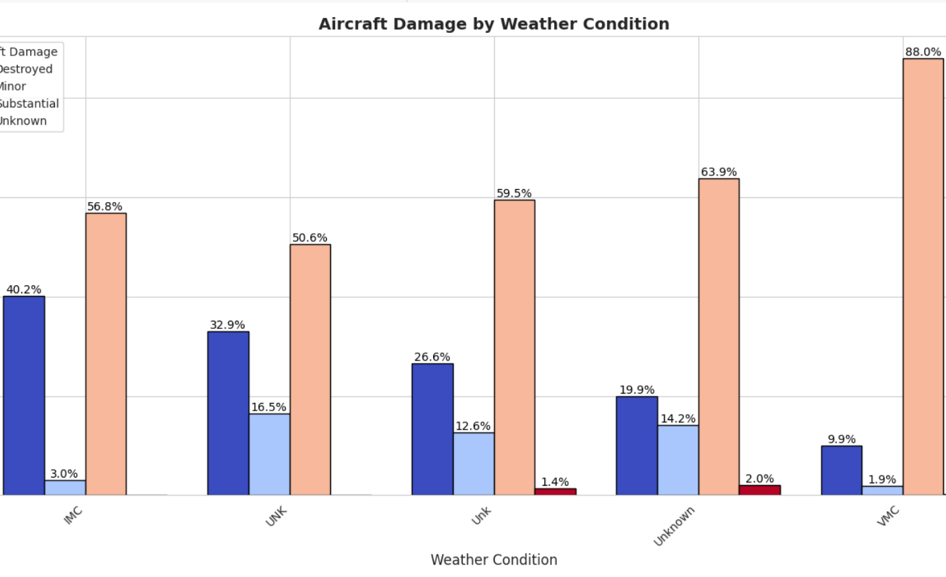
Data Analysis - Aircraft Damage By Weather Condition

Slide 6
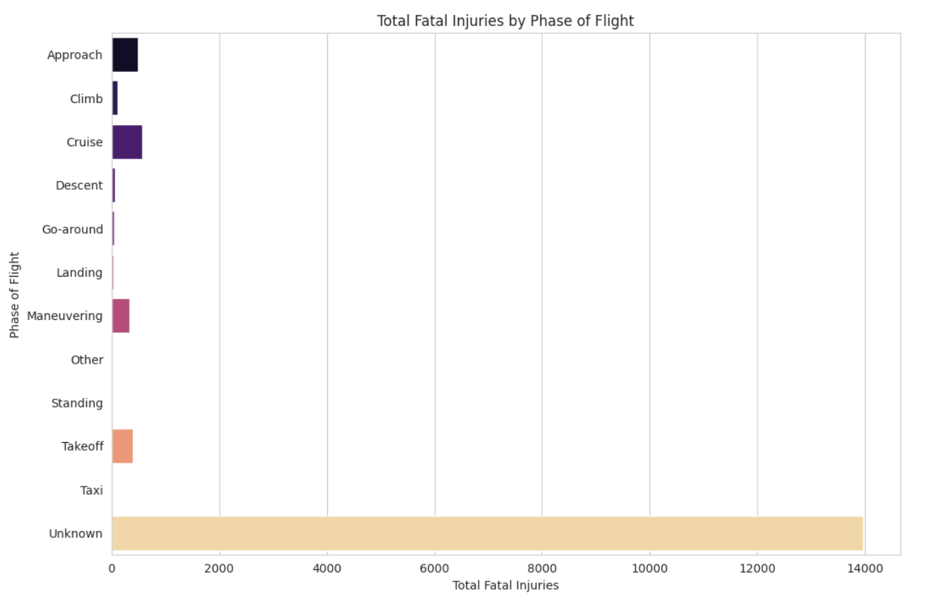
Data Analysis - Total Fatal Injuries By Phase of Flight

Slide 7
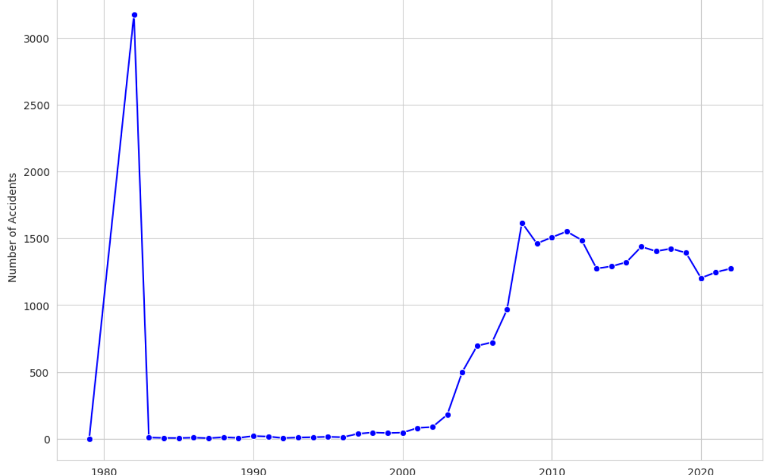
Data Analysis - Accident Trends over Time

Slide 8
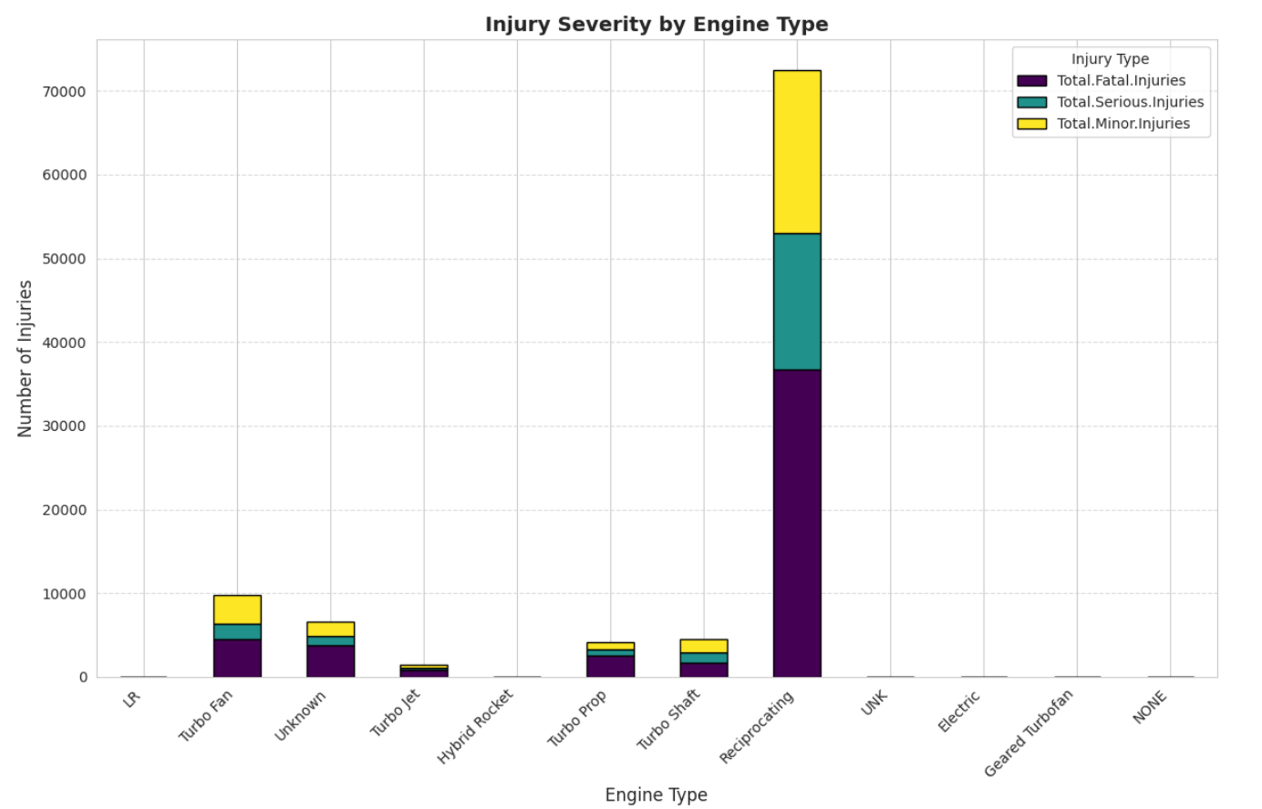
Data Analysis - Injury Severity By Engine Type

Slide 9
Recommendations
Focus on Safer Aircraft Makes.
Enhance Safety During Takeoff and Landing.
Choose Aircraft with Turbine Engines.
Avoid operating aircraft in adverse weather conditions

